Slide 1
Evaluation of Health Competences
Questionnaire designed to evaluate functional competences in the prevention of HIV transmission
University of Almeria, Spain
Gustavo García Vargas
Jesús Gil Roales-Nieto

Slide 2
The focus of this study is to evaluate the functional competencies related to the transmission of HIV/AIDS.

Slide 3
Psychological Dimension of the Health
Psychological Model of Biological Health
Contingencial Analysis (Functional Analysis)
Instrument’s parts
About Information
About Attitudes
About Functional Competencies

Slide 4
Questionnaire Structure
Categories of analysis | Competencies Level
 | Beliefs and Knowledge (information) | Specific preventive behaviors | Social Competencies | Particular preventive behavior (Condom Use)
 | Part I | Part II
Morphology | Items 1-4 | Items 1-4 | Items 17-20 | Items 33-26
People | Items 5-8 | Items 5-8 | Items 21-24 | Items 37-40
Situations | Items* 9-12 | Items** 9-12 | Items*** 25-28 | Items**** 41-44
Consequences | Items 13-16 | Items 13-16 | Items 29-32 | ------

Slide 5
I think that having sexual intercourse (including caresses, masturbation and/or penetration of any kind), when I have been drinking or am under the influence of any drug, is a behavior with: ** I suggest alternative sexual behaviors when I have been drinking or am under the influence of any drug and I have the opportunity for sexual intercourse (penetration of any kind): *** When I have been drinking or am under the influence of any drug and I have the opportunity for sexual intercourse (masturbation and/or penetration of any kind) I wait for my sexual partner to suggest the use of preventive measures: **** I use a condom when I have been drinking or am under the influence of any drug and I have the opportunity to have sexual intercourse (including penetration of any kind):
Maximum risk | 10 | 9 | 8 | 7 | 6 | 5 | 4 | 3 | 2 | 1 | 0 | Zero risk
Always | Most of the times | Occasionally | Never | I have never experienced this situation
Always | Most of the times | Occasionally | Never | I have never experienced this situation
Always | Most of the times | Occasionally | Never | I have never experienced this situation

Slide 6
The instrument was translated in 7 language and applied in two versions (in print and via Internet)
Version | Mexico | Spain | Colombia | Hungary | German | USA | Ireland | Portugal | Poland
Paper
Electronic
Participants | 258 | 60 | 32 (web) | 79 | 7 (web) | 00 | 00 | 00 | 00

Slide 7
Results: Information
Prevention level

Slide 8
Results: Attituds
Risk level

Slide 9
Results: Competencies rate
Prevention level

Slide 10
Reliability and Validity
Measurable properties internationality accepted

Slide 11
 | Group 1 Paper version |  | Group 2 Electronic version
N | 119 |  | 119
Age range | 16-45 |  | 16-48
Age average | 23 |  | 26
Men | 50.4% |  | 31.1%
Women | 49.6% |  | 68.9%
Level of education | Frequency | Percentage | Frequency | Percentage
Elementary | 1 | 0.8% | 1 | 0.8%
Middle School | 14 | 11.8% | 1 | 0.8%
High School | 35 | 29.4% | 17 | 14.3%
Undergraduate | 64 | 53.8% | 89 | 74.8%
Postgraduate | 2 | 1.7% | 11 | 9.2%
Not answered | 3 | 2.5% | ---- | ----
Profession
Student | 76 | 63.9% | 27 | 22.5%
Employee | 38 | 31.9% | 93 | 75.5%
Not answered | 5 | 4.2% | --- | ---
Marital Status
Single | 101 | 84% | 92 | 77.3%
Married | 12 | 10.1% | 16 | 13.4%
Cohabitation | 3 | 2.5% | 10 | 8.4%
Divorced | 2 | 1.7% | 1 | 0.8%
Not answered | 1 | 0.8% | -- | ----

Slide 12
Reliability and Validity
Measurable properties internationality accepted
Components | % variation explained | Alfa Cronbach’s Coefficient
Group 1 (paper version)
Factor 1. Social competencies level (4 situations/4 people) | 25.2 | 0.923
Factor 2. Specific preventive behaviors (3 people /3 situations /1 morphology) | 8.5 | 0.868
Factor 3. Particular preventive behavior (Condom use, 2 people/2 situations) | 6.2 | 0.864
Factor 4. Couple (3 morphology/ 2 people) | 5 | 0.747
Factor 5. Social Competencies (4 consequences) | 4.6 | 0.924
Factor 6. Beliefs and Knowledge (3 people/ 2 situations) | 4 | 0.846
Factor 7. Beliefs and Knowledge (4 consequences) | 3.6 | 0.824
Factor 8. Specific preventive behaviors (3 situations) | 3 | 0.785
Total | 60.5 | 0.877
Group 2 (internet version)
Factor 1. Particular preventive behavior (Condom use, 3 people /3 situations/1 morphology) | 18.5 | 0.9
Factor 2. Beliefs and Knowledge (3 people/2 morphology /1 situations) | 9.9 | 0.877
Factor 3. Social competencies level (4 people / 4 situations) | 7.7 | 0.89
Factor 4. Social competencies level (4 consequences) | 5.6 | 0.889
Factor 5. Specific preventive behaviors I (3 situations / 1 people) | 4.9 | 0.868
Factor 6. Beliefs and Knowledge (consequences) | 3.9 | 0.856
Factor 7. Specific preventive behaviors II (2 morphology / 1 people / 1 consequences). | 3.8 | 0.853
Factor 8. Specific preventive behaviors III (2 consequences / people) | 3.2 | 0.702
Total | 57.9 | 0.833

Slide 14
Discusion
The results showed a high reliability in both samples (α = 0.877 and α = 0.868), with a high internal consistency, besides having a construct validity. With these results and considering that sexual behavior is a taboo topic, we are considering the possibility to continue using electronic resources.
We believe that the anonymous status of the internet lets the participants express real behavior, this way we can get reliable data and clarify those factors that underlie sexual behavior.
Finally it is convenient to emphasize the way the data collected fits the theoretical model used, this is possible to observe by the variation of percentage explained by the components analyzed with the factor analysis.
We confirm the appropriateness of the model used in the explanation of risky sexual behavior.

Slide 15
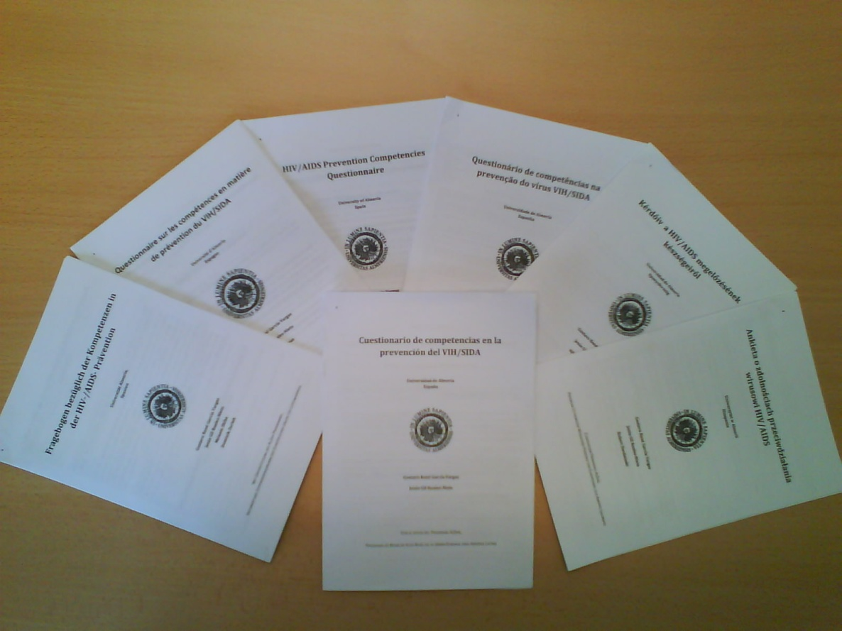
HIV/AIDS Prevention Competencies Questionnaire
Correspondence should be
directed to:
Gustavo René García Vargas
University of Almeria, Spain
Department of Personality,
Evaluation and Psychological
Treatments, 04120 Almeria, Spain
Email: gustavogarcia@ual.es

Slide 17
Results: Competencies rate
Mexico
Spain
Colombia
Hungary
Germany

